Slide 1
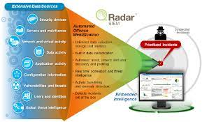
CYBER SECURITY WITH IBM QRADAR

Slide 2
CONTENTS
Introduction to cyber security
Networking TCP and OSI Model
Ports
Protocols
Introduction to python

Slide 3
Introduction to cyber security
Cyber Security is a process that’s designed to protect networks and devices from external threats. Businesses typically employ cyber security professionals to protect their confidential information, maintain employee productivity, and enhance customer confidence in products and services.
The world of Cyber Security revolves around the industry standard of confidentiality, integrity, and availability. Privacy means data can be accessed only by authorized parties; integrity means information can be added, altered, or removed only by authorized users; and availability means systems, functions, and data must be available on-demand according to agreed-upon parameters.
The main element of Cyber Security is the use of authentication mechanisms. For example, a user name identifies an account that a user wants to access, while a password is a mechanism that proves the user is who he claims to be.

Slide 4
Types of cyber security
Ten types of cyber security
1. Application security
2. Cloud security
3. Critical infrastructure security
4. Data security
5. Endpoint security
6. IoT (Internet of Things) security
7. Mobile security
8. Network security
9. Operational security
10. Zero trust

Slide 5
Application security
Application security prevents unauthorized access and use of applications and connected data. Because most vulnerabilities are introduced during the development and publishing stages, application security includes many types of cybersecurity solutions to help identify flaws during the design and development phases that could be exploited and alert teams so they can be fixed.
Despite best efforts, flaws do slip through the cracks. Application security also helps protect against these vulnerabilities.

Slide 6
Cloud security
Cloud security focuses on protecting cloud based assets and services, including applications, data, and infrastructure. Most cloud security is managed as a shared responsibility between organizations and cloud service providers.
Data Security
A subset of information security, data security combines many types of cyber security solutions to protect the confidentiality, integrity, and availability of digital assets at rest (i.e., while being stored) and in motion (i.e., while being transmitted).

Slide 7
Critical infrastructure security
Special security processes and types of cyber security solutions are used to protect the networks, applications, systems, and digital assets depended on by critical infrastructure organizations (e.g., communications, dams, energy, public sector, and transportation). Critical infrastructure has been more vulnerable to cyber attacks that target legacy systems, such as SCADA (supervisory control and data acquisition) systems. While critical infrastructure organizations use many of the same types of cyber security as other subcategories, it is often deployed in different ways.

Slide 8
Endpoint security
Desktops, laptops, mobile devices, servers, and other endpoints are the most common entry point for cyber attacks. Endpoint security protects these devices and the data they house. It also encompasses other types of cyber security that are used to protect networks from cyber attacks that use endpoints as the point of entry.
IOT (Internet of Things) security
IOT security seeks to minimize the vulnerabilities that these proliferating devices bring to organizations. It uses different types of cyber security to detect and classify them, segment them to limit network exposure, and seek to mitigate threats related to un patched firmware and other related flaws.

Slide 9
Mobile security
Mobile security encompasses types of cyber security used to protect mobile devices (e.g., phones, tablets, and laptops) from unauthorized access and becoming an attack vector used to get into and move networks.
Network security
Network security includes software and hardware solutions that protect against incidents that result in unauthorized access or service disruption. This includes monitoring and responding to risks that impact network software (e.g., operating systems and protocols) and hardware (e.g., servers, clients, hubs, switches, bridges, peers, and connecting devices).
The majority of cyber attacks start over a network. Network cyber security is designed to monitor, detect, and respond to network-focused threats.

Slide 10
Operational security
Operational security covers many types of cyber security processes and technology used to protect sensitive systems and data by establishing protocols for access and monitoring to detect unusual behavior that could be a sign of malicious activity.
Zero trust
The zero trust security model replaces the traditional perimeter-focused approach of building walls around an organization’s critical assets and systems. There are several defining characteristics of the zero trust approach, which leverages many types of cyber security.

Slide 11
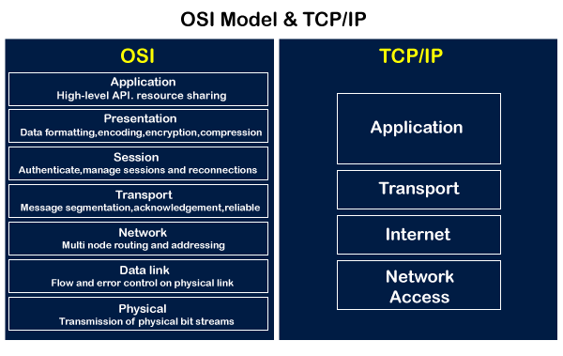
OSI AND TCP/IP MODEL

Slide 12
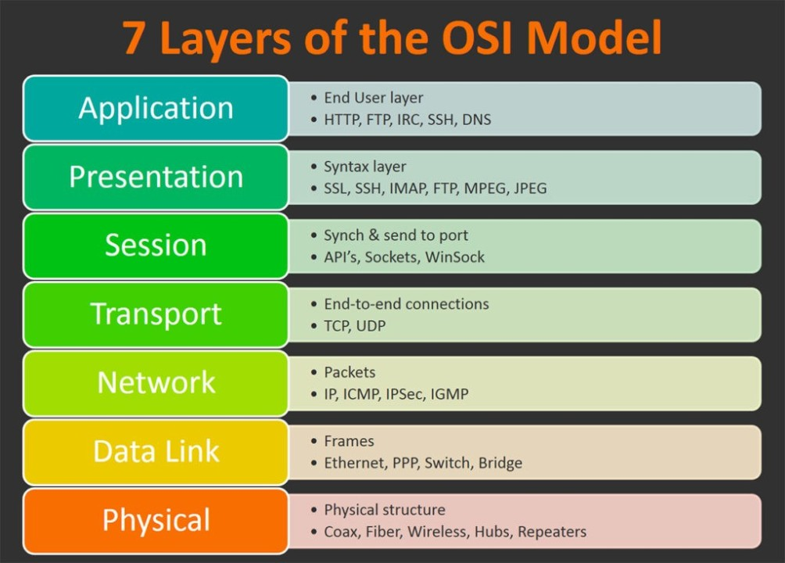
The Open system inter connection Open Systems (OSI) is an abstract representation of how the Internet works. It contains 7 layers, with each layer representing a different category of networking functions.

Slide 13
What is a port?
A port is a virtual point where network connections start and end. Ports are software-based and managed by a computer's operating system. Each port is associated with a specific process or service. Ports allow computers to easily differentiate between different kinds of traffic: emails go to a different port than web pages, for instance, even though both reach a computer over the same Internet connection.

Slide 14
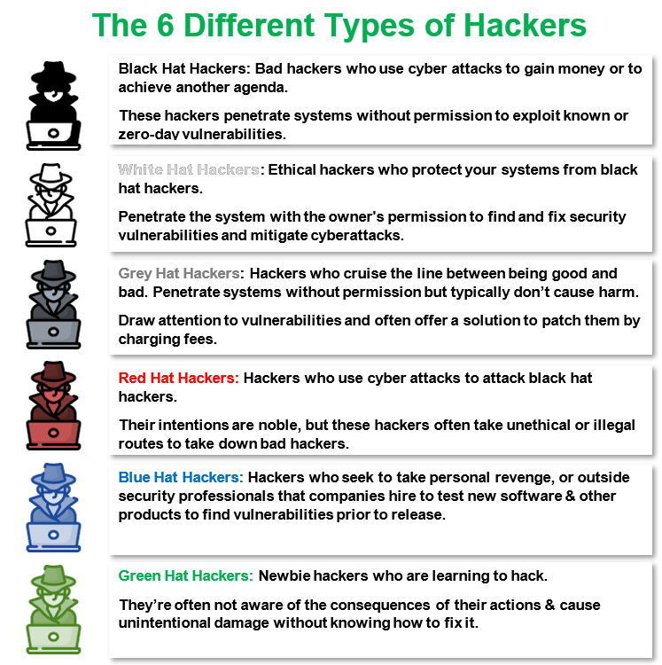

Slide 15
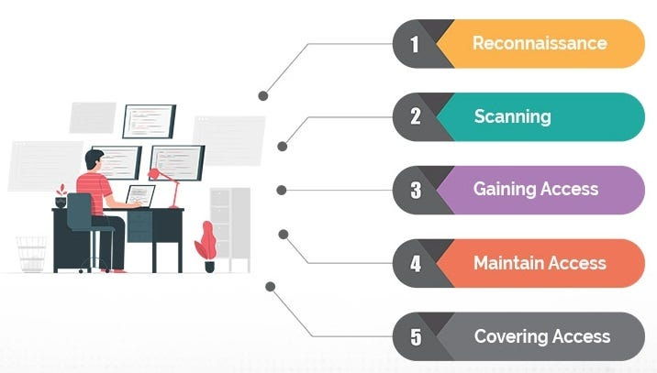
Phases of hacking

Slide 16
What is Python?
Python is an interpreted, object-oriented, high-level programming language with dynamic semantics. Its high-level built in data structures, combined with dynamic typing and dynamic binding, make it very attractive for Rapid Application Development, as well as for use as a scripting or glue language to connect existing components together. Python's simple, easy to learn syntax emphasizes readability and therefore reduces the cost of program maintenance. Python supports modules and packages, which encourages program modularity and code reuse. The Python interpreter and the extensive standard library are available in source or binary form without charge for all major platforms, and can be freely distributed.

Slide 17
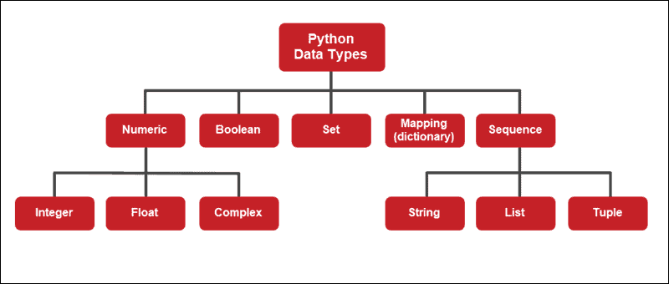
Data types of python

Slide 18
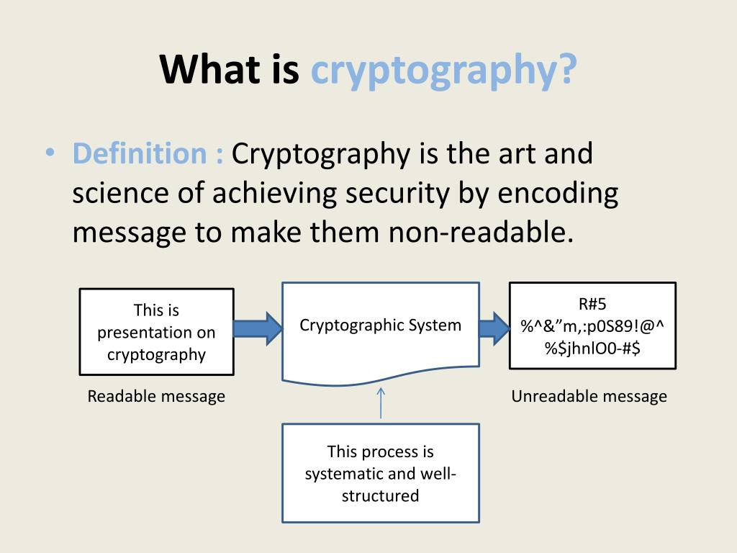

Slide 19
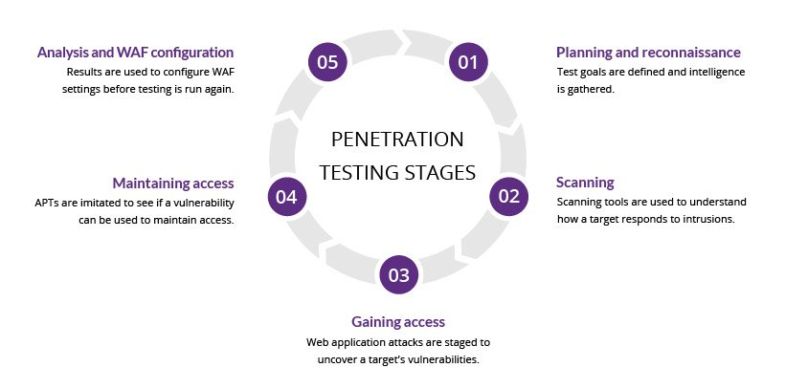
Penetration testing

Slide 20
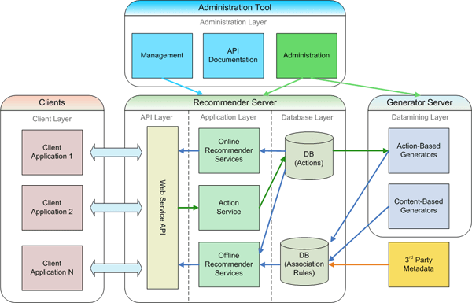
Web application architecture

Slide 21
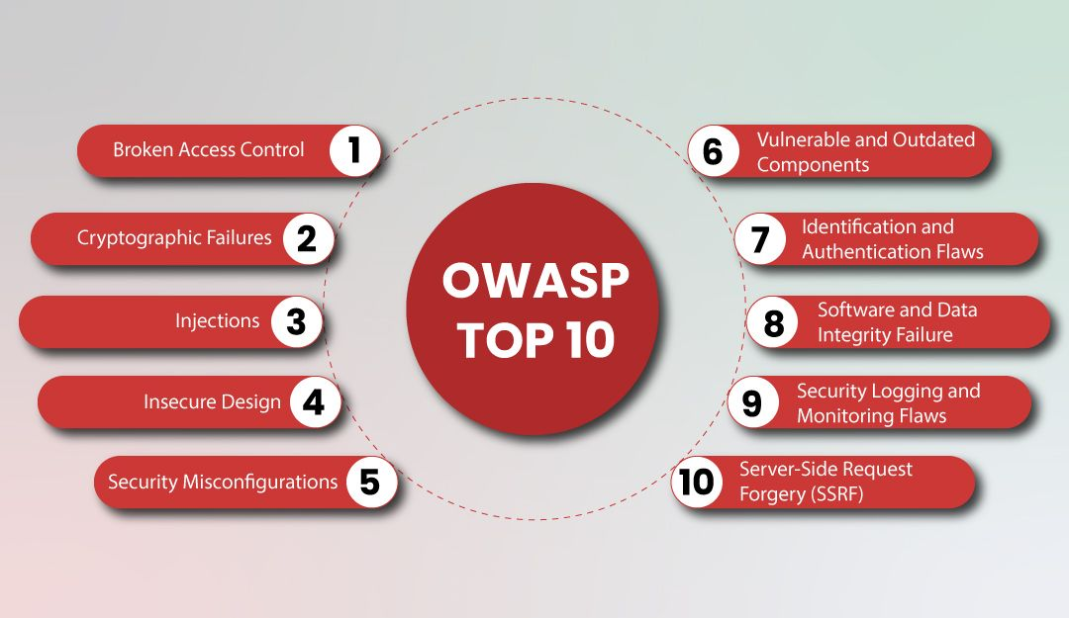
Top 10 web application security risks

Slide 22
Web services
The Internet is the worldwide connectivity of hundreds of thousands of computers of various types that belong to multiple networks. On the World Wide Web, a web service is a standardized method for propagating messages between client and server applications. A web service is a software module that is intended to carry out a specific set of functions. Web services in cloud computing can be found and invoked over the network. The web service would be able to deliver functionality to the client that invoked the web service.
A web service is a set of open protocols and standards that allow data to be exchanged between different applications or systems. Web services can be used by software programs written in a variety of programming languages and running on a variety of platforms to exchange data via computer networks such as the Internet in a similar way to inter-process communication on a single computer.

Slide 23
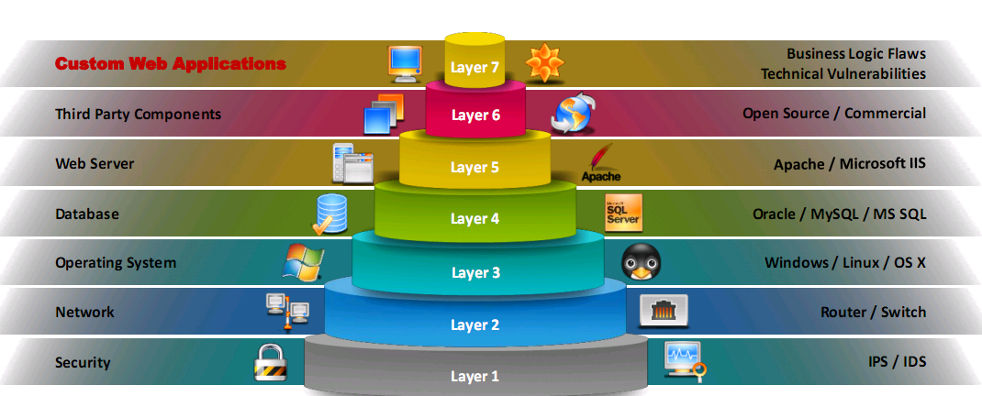
Vulnerability stack

Slide 24
NAME : GEDDADA SAI PAVANI
GROUP : B.COM(C.A)
H.T.NO : 2123017
TOPIC : CYBER SECURITY
COLLEGE: A.S.D.GOVT.DEGREE.COLLEGE FOR WOMEN (A) KAKINADA

Slide 25


